Slide 1
Diverse Identities in Sport Conference
Friday 4th March 2016
#DiverseSport

Slide 2
Transgender & Lawn bowling by Sadie Godiva
Some way to go for full inclusion in sport

Slide 3
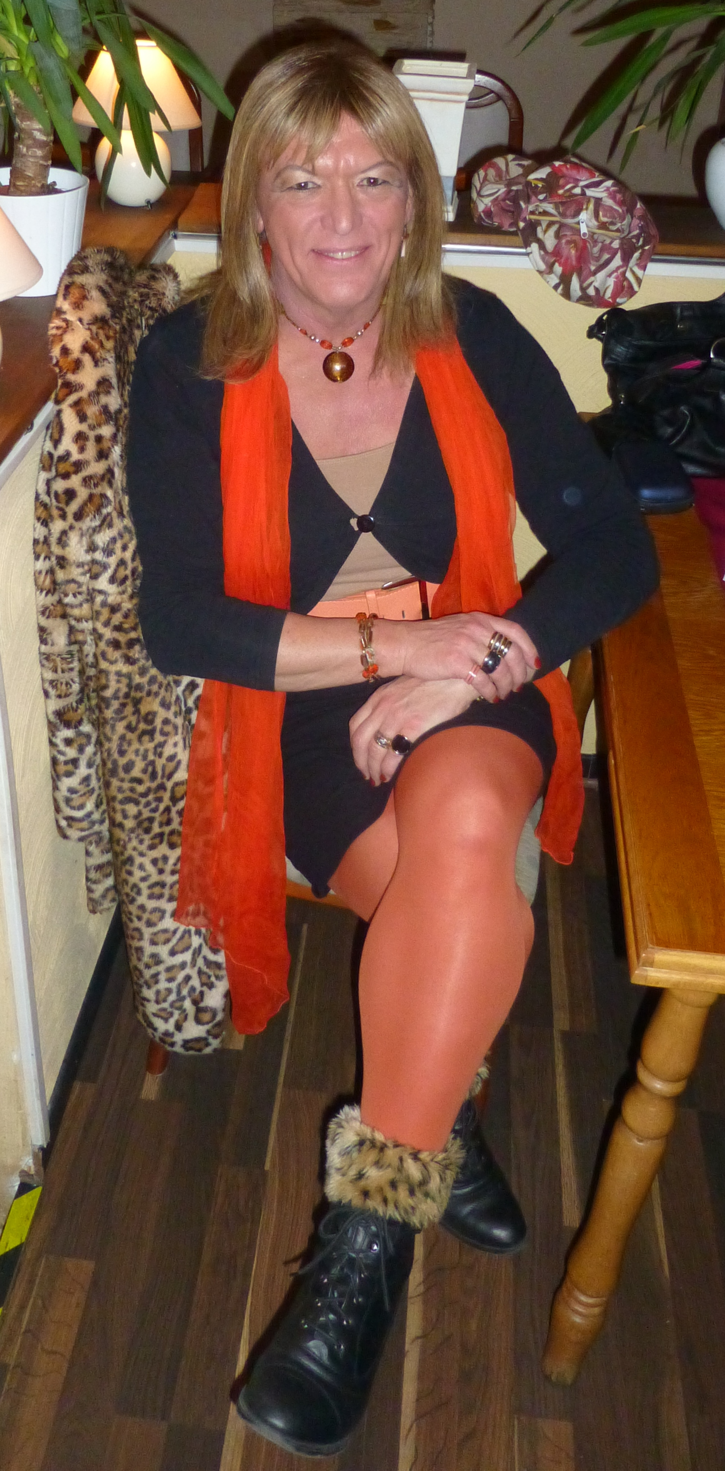
The Question
In January 2016 Sadie Godiva - recently transitioned woman and long time bowler - sent the following question to BOWLING associations in Scotland, England, South Africa and Australia.
What is your policy concerning transgender bowlers?

Slide 4
From Bowls England
1.2 Bowls England considers that the sport of outdoor flat green bowls is a gender-affected sport as the physical strength, stamina or physique of an average person of one gender may put them at an advantage or a disadvantage to an average person of the other gender.
1.3 Bowls England has produced this policy to manage the enquiries from, or about, persons who have legally acquired a change in their birth gender.
2.2 Any male-to-female transsexual who underwent gender reassignment surgery before puberty will be accepted in bowls as female. This also applies to individuals who have undergone female-to-male reassignment before puberty, who will be regarded as male.
2.3 With the exception of those highlighted in 2.2, only individuals who have acquired a UK Gender Recognition Certificate are eligible for participation in their acquired gender in matches under the control of Bowls England. Equivalent documentation issued by other nations will be considered on a case-by-case basis.

Slide 5
From Sadie to Bowls England
Thank you for sharing this document with me.
If I understand this policy correctly, this means that players whose situation does not conform with policies 2.2 and 2.3 will have their gender recognised as that assigned at birth. As a consequences, a male-to-female transgendered person may only compete in male events and or mixed events where she is regarded as male.
Does this also mean that a male-to-female transgendered person will not be allowed to wear a skirt when playing?. Which changing facilities will she be expected to use?

Slide 6
From Bowls England
Firstly, can I clarify by saying that – as Chief Executive of Bowls England – it is my particular responsibility to deal with inquiries relating to transgenderism.
Are you an MtF transsexual who has completed her transition, or are you still undertaking gender reassignment ?
Do you have a Gender Recognition Certificate, or are you not yet in a position to apply for legal gender recognition ?
Are you already a bowler or are you in the process of taking up the game ?
Do you already belong to a club and are seeking to transition as an existing member ?
If not already with a club, have you approached a club and are they aware of your situation ?

Slide 7
From Sadie to Bowls England
It's encouraging to know that I'm dealing directly with individual charged with overall responsibility for transgender matters. I am male-to-female transgendered, and lived part-time as a female for nearly three years before becoming full-time at the start of October last year. I am not in possession of a Gender Recognition Certificate (GRC) and it is likely to be some time before I get one. I have played bowls for more than twenty-five years. I resigned from my last club just before Christmas. I don't believe members at that club are aware of my transition, and no county association is involved.
I wish to return to the game, but am unwilling to do so until I am certain that every foreseeable question has been satisfactorily answered. My concerns are not for me alone. I'm sure there will be other transgendered individuals with an interested in the progress of my enquiry. Bowls England's policy concerning those in possession of a GRC is quite clear. It's the area between the start of transition and obtaining a GRC which needs to be addressed.

Slide 8
From Bowls England
As you have now divined, not having a GRC in no way prevents you from playing bowls at a club in England; the Bowls England Transgender Policy relates purely to the playing of competitive bowls under the aegis of Bowls England.
I wouldn’t treat your inquiry as anything that might have implications for any other transitioning bowls player, as I would regard each individual’s situation as entirely unique.
One possible perspective on this situation is that actively transitioning within a club – either a club of which one is already a member, or where a new club will be aware that the player is in the process of transitioning – is potentially more stressful for all involved, than taking a break as a player while one gets either some way through or wholly through the transitioning process, and then seeks a new club. I am not advocating such an approach, but it is food for thought.

Slide 9
From Bowls South Africa
Bowls South Africa does discriminate against any persons.
I wonder if the word NOT is missing from your reply. If so, in what sections/events/competitions would a male-to-female transgendered person be allowed/expected to compete? Men's or ladies'? Which changing facilities would they be allowed/expected to use? What defines a transgendered person under Bowls SA rules/policies?
I look forward to your reply.

Slide 10
From Bowls South Africa
Sorry, I misread your e-mail I thought you meant Gay persons. We do not have any transgender players so your questions have never arisen. Therefore we do not have any rules re transgendered persons.
From Sadie
Another shining example of misunderstanding and misinformation about the transgender community. Being transgendered has NOTHING to do with sexuality. Will Bowls SA be addressing this issue BEFORE a problem occurs?

Slide 11
From Bowls South Africa
I am very sad to see your reply, as I am not misinformed. I have gay son married to a wonderful man.
As a woman of 72, I recognised my son was gay at his tender age of 10. I have 2 cousins who are gay so was aware of the problem.
As we have never had a transgender person apply for membership, we have not given it any thought as I said.
Please let this matter rest as I do not need to enter into a dialogue with you.
From Sadie My enquiry was not about gay people, but you appear to have confused the two terms, gay and transgendered. Will you be bringing this matter before the full board of Bowls SA, for their consideration, or are you authorised to speak for the entire organisation?

Slide 12
From Media Officer Bowls South Africa
1 The word NOT was omitted in error by Ms A. She regrets that.
2 Bowls SA conforms to the Constitution of the Republic of South Africa and we, as a highly-rated Sports Federation with 25 000 members, would never discriminate against transgender people. We do not have an official policy in place as the matter has never been raised within our sport; but rest assured that would be the case..
3 Should there be a question of transgender arising, Bowls SA would deal with it with the clarity and good governance it applies to all its internal affairs.
4 I have been playing nationwide for 35 years, and while some people may be androgynous, others may prefer to assume exterior gender change in private life, I can remember only one person – now dead – who enjoyed that orientation. Should there be such a person(s) of either gender they would play under the terms and conditions of the sport enjoyed by all Bowls SA’s members, without distinction.
5 Bowls SA has been referred to by government as the ideal administration; all our democratically-elected executives and head office staff, have no prejudices of any kind based on race, religion, ethnicity or orientation.

Slide 13
Media Officer Bowls South Africa
Should you have any further inquiries in relations to the running of lawn bowls in South Africa, please feel free to ask me directly at any time.
PS. You might care to tell me if you represent an organisation? We would, for our records like to ensure we are able to enlighten you further with your inquiry should such an occurrence you infer materialises.
From Sadie
Thank you so much for your reply.
The question of transgender players has arisen. I'm here. Now.
Having been an active player who is now transitioning from male-to-female, I should like to know what to expect BEFORE I resume playing.
For example, which changing facilities will I be allowed/expected to use?
If condemned to be excluded from ladies events/competitions, will I still be allowed to wear a skirt? I look forward to hearing from you again.

Slide 14
From Media Officer Bowls South Africa
Hello again,
This must of course be facilitated for you.
To do this smoothly I need:
1 Your club at which you play
2 Your address so that correct correspondence may be entered into
3 Your SABA number
4 Where else you exercise your right to be transgender and how that is facilitated for you.
5 Your “male persona” name?
Assuring you of complete co-operation, please answer these simple questions for me.

Slide 15
From Sadie to Media Officer Bowls South Africa
Dear Mr S
I live full-time as a female.
I travel on buses, trains, aircraft and ships.
I ALWAYS use the ladies' toilet.
I insist that female pronouns are used when referring to me.
I explained that I am no longer active in bowls.
I do not have a current club, therefore I have no SABA number.
I am NOT prepared to reveal my postal address at this time.
My former identity is irrelevant.
Regards

Slide 16
From Media Officer Bowls South Africa
Hello again,
Since you are no longer active in bowls my assistance, although always available, would appear superfluous.
This correspondence is now ended until such time you again have interest in bowls and there is relevance in our discussion.
May I, on behalf of the executive of Bowls SA wish you a pleasant and productive life, respected and supported by those around you.
With kindest regards
This is the end of correspondence with Bowls SA 27 Jan 2016

Slide 17
From Bowls Australia
Member protection policy
6.6 Gender identity
Gender identity means the gender-related identity, appearance or mannerisms or other gender-related characteristics of a person. This includes the way people express or present their gender and recognises that a person’s gender identity may be an identity other than male or female. Some terms used to describe a person’s gender identity include trans, transgender and gender diverse.
6.6.1 Gender identity discrimination and harassment
All persons, regardless of gender identity, are entitled to be treated fairly and with dignity and respect at all times. We will not tolerate any unlawful discrimination or harassment of a person because of their gender identity. This includes discrimination or harassment of a person who is transgender or transsexual, who is assumed to be transgender or transsexual or has an association with someone who has or is assumed to be transgender or transsexual. Refer to the attachments in Part D of this policy.

Slide 18
From Sadie to Bowls Australia
Thank you so much for your reply. I have read the sentence dealing with Gender Identity. Does Bowls Australia already have examples of such cases? Without revealing identities of any persons involved, are you able to share more details about such cases?
Having been an active player who is now transitioning from male-to-female, I should like to know what to expect BEFORE I resume playing. For example, which changing facilities will I be allowed/expected to use? If condemned to be excluded from ladies events/competitions, will I still be allowed to wear a skirt?
I look forward to hearing from you again.

Slide 19
From Bowls Australia
Thanks again for your email.
I am only aware of one other player who has transitioned from male to female. I can't speak of her personal experience in any detail, but I do know that she played an Australian Open without issue and I think also played for her state/territory (again I believe without issue). Both were ladies events.
Again, I don't know intimate details of what her experience was like, but I was never made aware of any issue.
What I do know is that you will have our support in terms of ensuring that you are treated with respect, and remain free from harassment.

Slide 20
From Sadie to Bowls Australia
Your reply has given me hope and encouragement. Bowls Australia's member protection policy, in respect of transgendered people, appears to address many issues.
However, I have at least one more question.
Bowls is, and always has been, a sexist game, that's to say distinct Men's and Ladies' sections. At what point in their transition would a transgendered player be permitted to move from one section to another? As ever, I'm eager to receive your reply. 28 Jan 2016
This is the end of correspondence with Bowls Australia

Slide 21
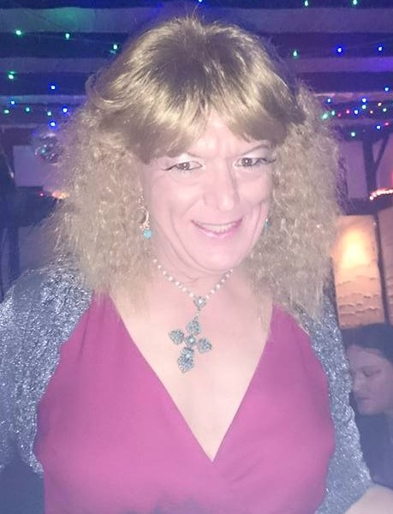
Bowls Scotland
In my own experience, the sport of lawn bowls is still very sexist, especially in Scotland.
I sincerely expect NO reply to my question sent to Bowls Scotland.

